Slide 1
JavaScript
JavaScript, originally called LiveScript, was developed by Brendan Eich at Netscape in 1995 and was shipped with Netscape Navigator 2.0 beta releases.
Why Study JavaScript?
– JavaScript is one of the 3 languages all web developers MUST learn:
Basically,
HTML to define the content of web pages
CSS to specify the layout of web pages
JavaScript to specify the behavior of web pages

Slide 2
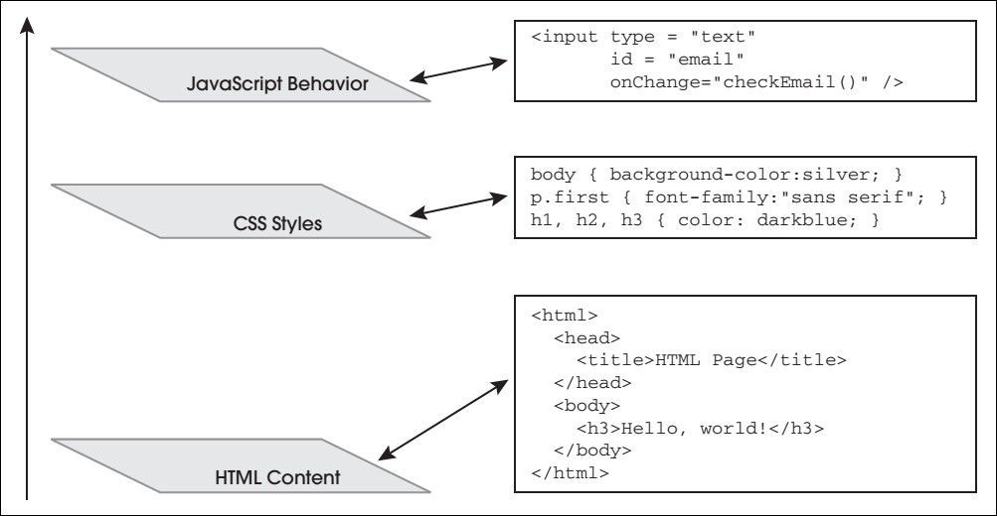
The Three Layers

Slide 3
JavaScript Introduction
JavaScript is the most popular programming language in the world.
JavaScript is the language for the web, for HTML, for servers, PCs, laptops, tablets, cell phones, and more.
JavaScript is a Scripting Language
A scripting language is a lightweight programming language.
JavaScript code can be inserted into any HTML page, and it can be executed by all types of web browsers.

Slide 4
JavaScript Where To
In HTML, JavaScripts must be inserted between
<script> and </script> tags.
JavaScripts can be put in the <body> and in the <head> section of an HTML page.
The <script> Tag
To insert a JavaScript into an HTML page, use the <script> tag.
The <script> and </script> tells where the JavaScript starts
and ends.
The lines between the <script> and </script> contain the JavaScript code:
In syntax, JavaScript is similar to C, Perl, and Java

Slide 5
JavaScript Functions and Events
Most often, JavaScript code is written to be executed when an event occurs, like when the user clicks a button.
If we put JavaScript code inside a function, we can call that function when an event occurs.
We will see examples in coming slides

Slide 6
JavaScript in <head> or <body>
You can place an unlimited number of scripts in an HTML document.
Scripts can be in the <body> or in the <head> section of HTML, and/or in both.
It is a common practice to put functions in the
<head> section, or at the bottom of the page.
Separating HTML and JavaScript, by putting all the code in one place, is always a good habit.

Slide 7
JavaScript in <head>
<!DOCTYPE html>
<html><head>
<script>
function myFunction()
{
document.getElementById("demo").innerHTML="My First JavaScript Function";
}
</script>
</head>
<body>
<form>
<h1>My Web Page</h1>
<p id="demo">A Paragraph</p>
<input type=“submit" onClick="myFunction()“ >
</form>
</body>
</html>

Slide 8
JavaScript in <body>
<!DOCTYPE html>
<html>
<body><h1>My Web Page</h1>
<p id="demo">A Paragraph</p>
<input type=“Submit" onclick="myFunction()“ value=“Try it”>
<script>
function myFunction()
{
document.getElementById("demo").innerHTML="My First
JavaScript Function";
}
</script>
</body>
</html>

Slide 9
External JavaScripts
Scripts can also be placed in external files. External files often
contain code to be used by several different web pages.
External JavaScript files have the file extension .js.
To use an external script, put the name of the script file in the
source (src) attribute of the <script> tag: e.g.
<!DOCTYPE html>
<html>
<body>
<script src="myScript.js"></script>
</body>
</html>
You can place an external script reference in <head> or <body> as you like. The script will behave as if it was located exactly where you put the reference in the HTML document.

Slide 10
JavaScript Output
JavaScript does not have any print or output functions.
In HTML, JavaScript can only be used to manipulate HTML elements.
Manipulating HTML Elements
– To access an HTML element from JavaScript, you can use the document.getElementById(id) method. Use the "id" attribute to identify the HTML element.

Slide 11
Example
<!DOCTYPE html>
<html>
<body>
<h1>My First Web Page</h1>
<p id="demo">My First Paragraph</p>
<script>
elem = document.getElementById("demo"); elem.innerHTML = "My First JavaScript";
</script>
</body>
</html>

Slide 12
Example
The JavaScript example above is executed by the web browser. First, the browser will find the HTML element with id="demo":
elem = document.getElementById("demo");
Then it will replace the element's content (innerHTML) with a new content:
elem.innerHTML = "My First JavaScript".
Note: innerText represents only text content while innerHTML represents complete html content with tags.

Slide 13
JavaScript Syntax
In HTML, JavaScript is a sequence of statements that can be executed by the web browser.
JavaScript Statements
JavaScript statements are "commands" to the browser.
The purpose of the statements is to tell the browser what to do.
This JavaScript statement tells the browser to write "Hello world" inside an HTML element with id="demo": e.g.
document.getElementById("demo").innerHTML="Hello World";
; Semicolon separates JavaScript statements. Normally you add a semicolon at the end of each executable statement.

Slide 14
JavaScript Code
javaScript code (or just JavaScript) is a sequence of JavaScript statements.
Each statement is executed by the browser in the sequence they are written.
This example will manipulate two HTML elements:
– document.getElementById("demo").innerHTML=" Hello World";
document.getElementById("myDIV").innerHTML= "How are you?";

Slide 15
JavaScript Code Blocks
JavaScript statements can be grouped together in blocks.
Blocks start with a left curly bracket, and end with a right curly bracket.
The purpose of a block is to make the sequence of statements execute together.
A good example of statements grouped together in blocks, are in JavaScript functions. E.g.
function myFunction()
{
document.getElementById("demo").innerHTML="Hello World";
document.getElementById("myDIV").innerHTML="How are you?";
}

Slide 16
JavaScript Identifiers
All programming languages must identify keywords, variables, methods, properties, and labels, with unique names.
In JavaScript these unique names are called identifiers.
A JavaScript identifier must begin with a letter, or an underscore (_), or a dollar sign ($). The other characters in the identifier, can be letters, digits, underscores, and dollar signs. Some JavaScript identifiers are reserved as keywords for JavaScript itself, and cannot be used as identifiers in a script.

Slide 17
Reserved Keywords
abstract | else | instanceof | super
boolean | enum | int | switch
Double | Static | In | with
break | export | interface | synchronized
do | Import | Short | while
byte | extends | let | this
Delete | Implements | Return | volatile
case | false | long | Throw
Default | Public | If | Void
catch | final | native | throws
Debugger | Goto | Protected | var
char | finally | new | Transient
Continue | Function | Private | Typeof
class | float | null | True
const | For | Package | Try

Slide 18
JavaScript is Case Sensitive
JavaScript is case sensitive.
Watch your capitalization closely when you write JavaScript statements:
All identifiers, keywords, variables, methods, properties, and functions are case sensitive.
A variable named myVariable, and a variable named MyVariable, are two different variables.
The function getElementById cannot executed by calling getElementbyID.

Slide 19
JavaScript
JavaScript Character Set : javaScript uses the Unicode character set. Unicode covers (almost) all the characters, punctuations, and symbols in the world.
JavaScript White Space: JavaScript ignores extra spaces. You can add white space to your script to make it more readable. E.g. following lines are equivalent
var person1 = “Hamid”;
var person2 = “Jameel”;

Slide 20
JavaScript Comments
JavaScript comments can be used to make the code more readable. Comments can be added to explain the JavaScript, or to make the code more readable.
Single line comments start with //.
JavaScript Multi-Line Comments starts /* and end with */.
Using Comments at the End of a Line e.g.
var x = 5; // Declare x and assign 5 to it
var y = x + 2; // Declare y and assign x + 2 to it

Slide 21
JavaScript Variables
JavaScript variables are "containers" for storing information:
var x = 5;
var y = 6;
var z = x + y;
Variable names must begin with a letter
Variable names can also begin with $ and _ (but we will not use it)
Variable names are case sensitive (y and Y are different variables)

Slide 22
JavaScript Variables
JavaScript variables can also hold other types of data, like text
values ( person="Jawad Ali" ).
In JavaScript a text like "Jawad Ali" is called a string.
There are many types of JavaScript variables, but for now, just think
of numbers and strings.
When you assign a text value to a variable, put double or single quotes around the value.
When you assign a numeric value to a variable, do not put quotes around the value. If you put quotes around a numeric value, it will be treated as text.
Examples var pi=3.14;
var person=“Jawad Ali";
var answer='Yes I am!';

Slide 23
Declaring JavaScript Variables
Creating a variable in JavaScript is most often referred to as "declaring" a variable.
You declare JavaScript variables with the var keyword: e.g. var carname;
To assign a value to the variable, use the equal sign: e.g. carname=“Volvo”;
You can declare many variables in one statement. Just start the statement with var and separate the variables by comma: e.g.
var lastname=“Ali", age=30, job=“Manager";

Slide 24
JavaScript Variables (Conti.)
Value = undefined: In computer programs, variables are often declared without a value. The value can be something that has to be calculated, or something that will be provided later, like user input. Variable declared without a value will have the value undefined.
Re-Declaring JavaScript Variables: If you re- declare a JavaScript variable, it will not lose its value: e.g.
var carname="Volvo";
var carname;

Slide 25
JavaScript Data Types
String, Number, Boolean, Array, Object, Null, Undefined.
JavaScript has dynamic types. This means that the same variable can be used as different types: e.g.
var x; var x = 5;
// Now x is undefined
// Now x is a Number
var x = "John"; // Now x is a String

Slide 26
JavaScript Data Types (cont.)
JavaScript Strings :A string is a variable which stores a series of characters like “Hello world".
A string can be any text inside quotes. You can use single or double quotes:e.g.
var carname = "Volvo XC60";
var carname = 'Volvo XC60';
JavaScript Numbers: JavaScript has only one type of numbers. Numbers can be written with, or without decimals: e.g.
var x1=34.00;
var x2=34;
// Written with decimals
// Written without decimals

Slide 27
JavaScript Data Types
JavaScript Booleans: Booleans can only have two values: true or false. E.g.
var x = true; var y = false;
JavaScript Arrays: The following code creates an Array called cars:
var cars=new Array(); cars[0]="Saab";
cars[1]="Volvo";
cars[2]="BMW";
Condensed Array
var cars = new Array("Saab","Volvo","BMW");
Literal Array
var cars = ["Saab","Volvo","BMW"];

Slide 28
JavaScript Data Types
JavaScript Objects: An object is delimited by curly braces. Inside the braces the object's properties are defined as name and value pairs (name : value). The properties are separated by commas: e.g.
var person = {
firstname:“Javed“,
lastname:“khan",
id:5566
};
You can access the object properties in two ways:
name = person.lastname;
name = person["lastname"];

Slide 29
JavaScript Data Types
Undefined and Null: Undefined is the value of a variable with no value. Variables can be emptied by setting the value to null; e.g.
cars = null; person = null;
Declaring Variables as Objects: When a variable is declared with the keyword "new", the variable is declared as an object: e.g.
var name = new String;

Slide 30
JavaScript Objects
Almost everything in JavaScript can be an Object: Strings, Functions, Arrays, Dates....
Objects are just data, with properties and methods.
Properties and Methods
Properties are values associated with objects. E.g. The properties of the car include name, model, weight,
color, etc.
Methods are actions that objects can perform. E.g. The methods of the car could be start(), drive(), brake(),
etc.

Slide 31
JavaScript Objects
Creating JavaScript Objects
Almost "everything" in JavaScript can be objects. Strings, Dates, Arrays, Functions....
You can also create your own objects.
This example creates an object called "person", and adds four properties to it:
Examples:
person = new Object();
person.firstname = “Javed”;
person.lastname = “Khan”;
person.age = 50;
person.eyecolor=“blue”;

Slide 32
JavaScript Objects
Accessing Object Properties
The syntax for accessing object property is
objectName.propertyName
Example:
var message="Hello World!";
var x=message.length; // output: 12
Accessing Object Methods
objectName.methodName()
var message = "Hello world!";
var x = message.toUpperCase(); // HELLO WORLD

Slide 33
JavaScript Functions
A function is a block of code that will be executed when "someone" calls it:
Function Syntax:
function functionname() {
// some code to be executed
}
Calling function in html button tag as follow
<button onclick=“functionname()">Try it</button>

Slide 34
JavaScript Functions
Functions With a Return Value: Sometimes you want your function to return a value back to where the call was made. This is possible by using the return statement.
function myFunction(){
var x=5; return x;
}
var myVar=myFunction();
You can also use the return value without storing it as a variable: e.g.
document.getElementById("demo").innerHTML=myFunction();

Slide 35
Local & Global JavaScript Variables
Local JavaScript
A variable declared (using var) within a JavaScript function becomes LOCAL and can only be accessed from within that function. (the variable has local scope).
You can have local variables with the same name in different functions, because local variables are only recognized by the function in which they are declared.
Local variables are deleted as soon as the function is completed.
Gloabl javaScript variable
Variables declared outside a function, become GLOBAL,
and all scripts and functions on the web page can access it.

Slide 36
JavaScript Variables
The Lifetime of JavaScript Variables
The lifetime of JavaScript variables starts when they are declared.
Local variables are deleted when the function is completed.
Global variables are deleted when you close the page. Assigning Values to Undeclared JavaScript Variables
If you assign a value to a variable that has not yet been declared, the variable will automatically be declared as a GLOBAL variable.
This statement declares a global variable:
car = “Volvo”;

